Slide 1
Burns Elementary
is an overall
Recognized Campus
under House Bill 5 Community and Student Engagement*
BISD is rated overall Recognized for CASE*
* House Bill 5, Section 46; Texas Education Code Section 39.0545

Slide 2
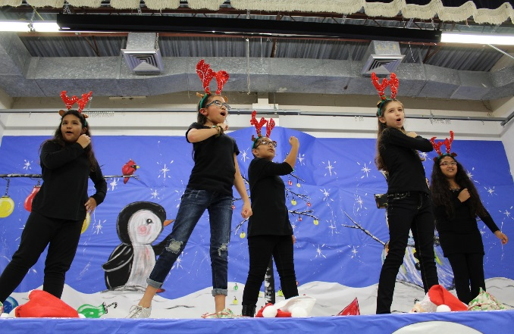
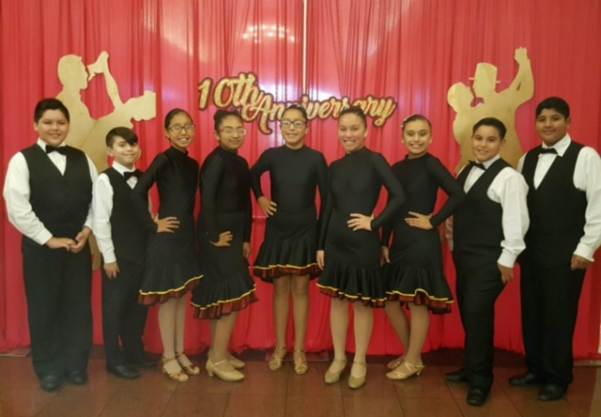
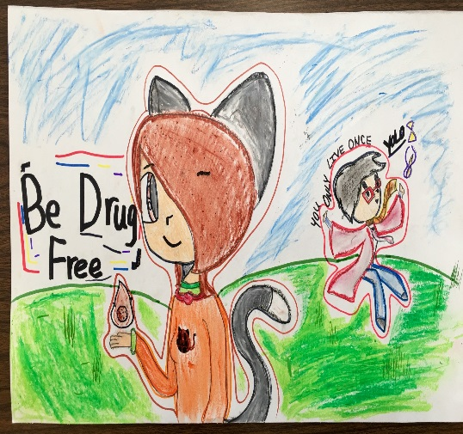
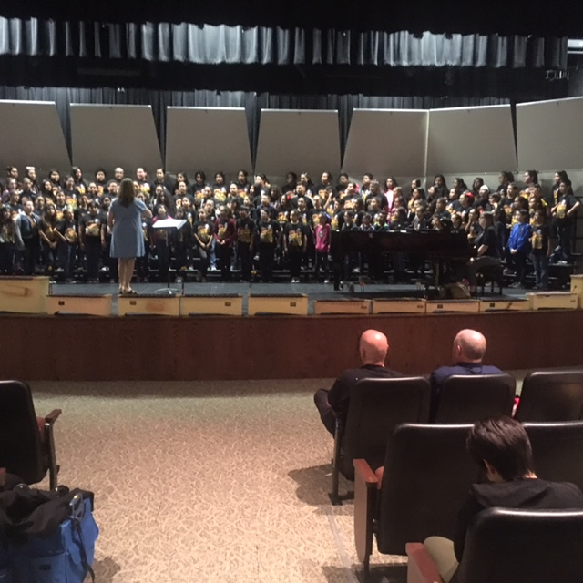
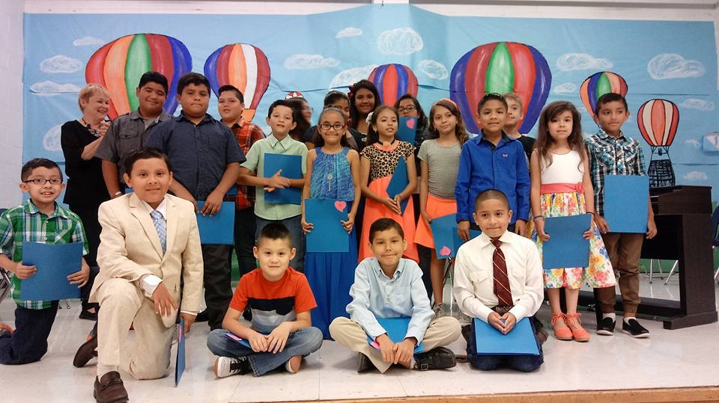
Fine Arts Program rated Recognized
UIL Music Memory, UIL Art Smart, All-City Choir, Autism Awareness Art Show, TASA/TASB Convention Art Exhibit, Ballroom Competition, Dance Team, Charro Days Parade, Fiesta Folklorica, RGV Birding Festival, Red ribbon Poster Contest, Student International Art Show, Charro Days Art Contest, Take Care of Texas, Kids Voting USA, and BISD Elementary Art Competition

Slide 3
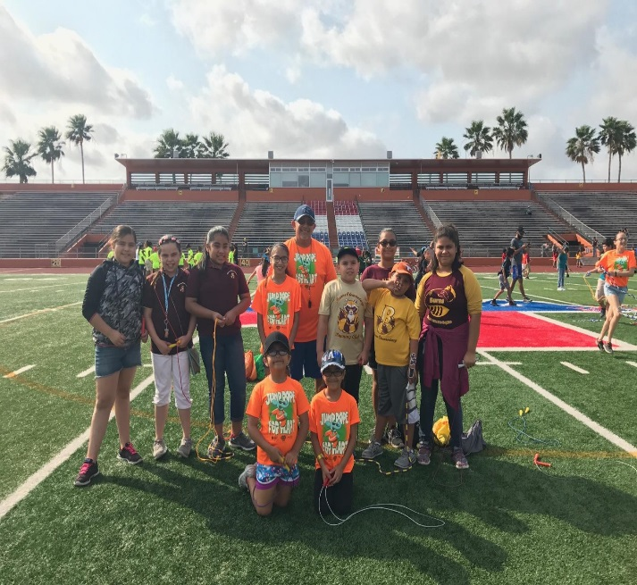
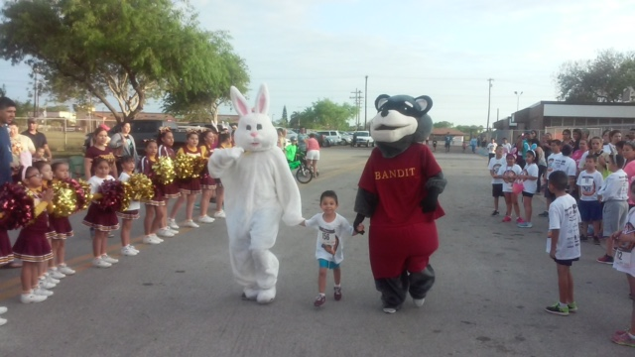
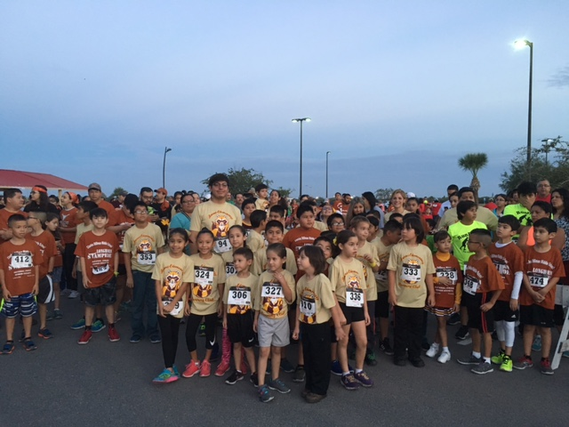
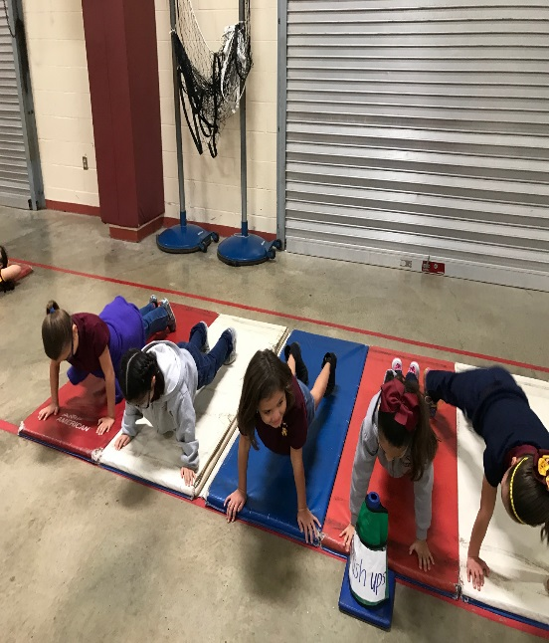
Wellness Program rated Exemplary
Running Club (Dolphin Dash, Bunny Run, Shamrock Run, Share the Love Run, Red Ant Run, Jingle Bell run, Longhorn Stampede Run and Run with the Police), Volleyball and Soccer Teams, and BISD Flag Football. Participated in Elementary PE Demonstration , Jump Rope for Heart, and Red Ribbon Week Events. The campus had 100% Fitness Gram Participation and participated in 2 Health Screenings.

Slide 4
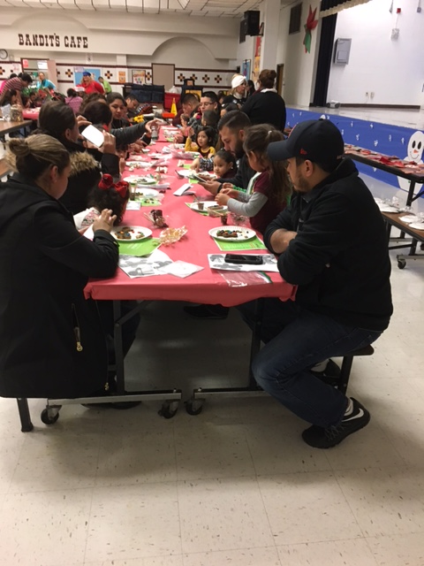
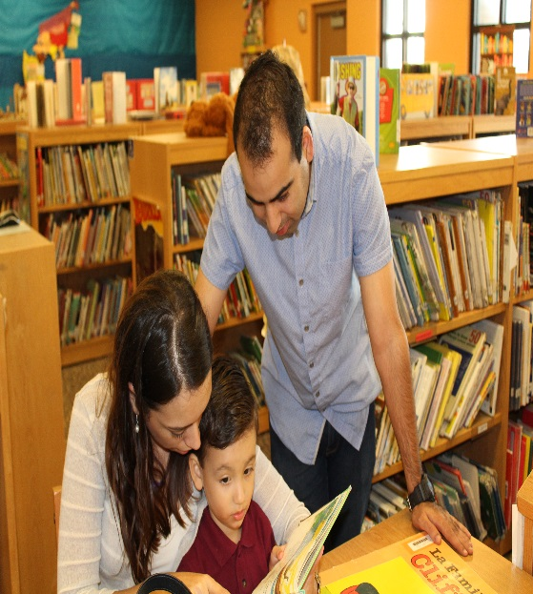
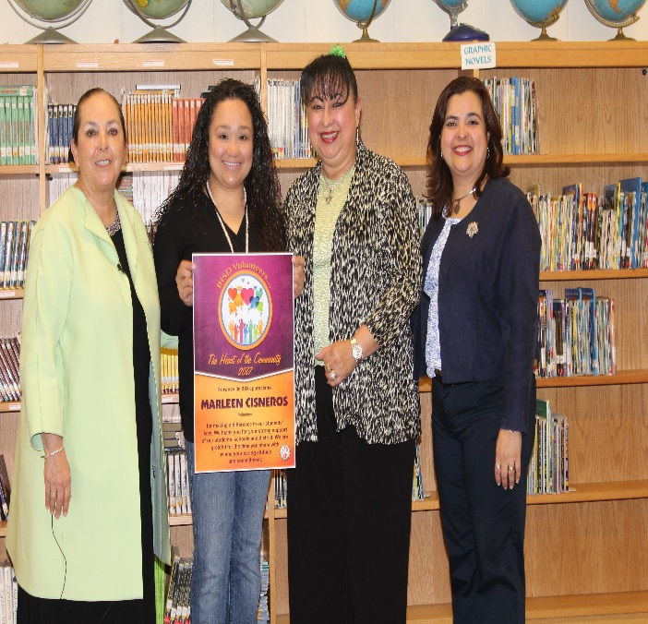
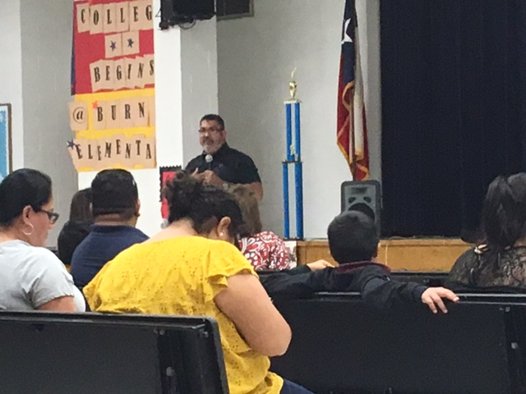
Community and Parental Involvement rated Recognized
During the 2016-2017 school year, the students participated in community activities such as: Canned Food Drive, Jump Rope for Heart, Blood Drive, Health Fair, Teddy Bear Cop, City Health Dept. Rabies Clinic, Sombrero Festival, Army Toy Drive, Ozanam Center Inc. Clothing Donation and various races . Our Parent Liaison helped support our parental involvement with numerous Parent meetings and our school nurse provided parents with Health Education and Awareness.

Slide 5
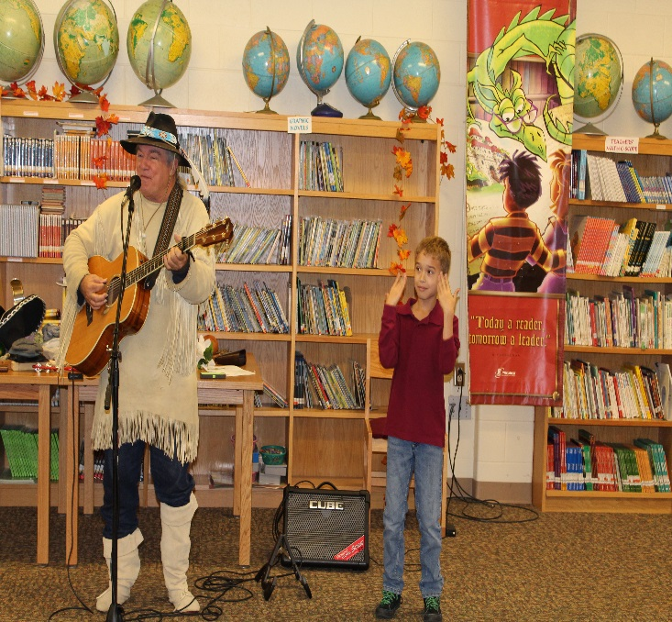
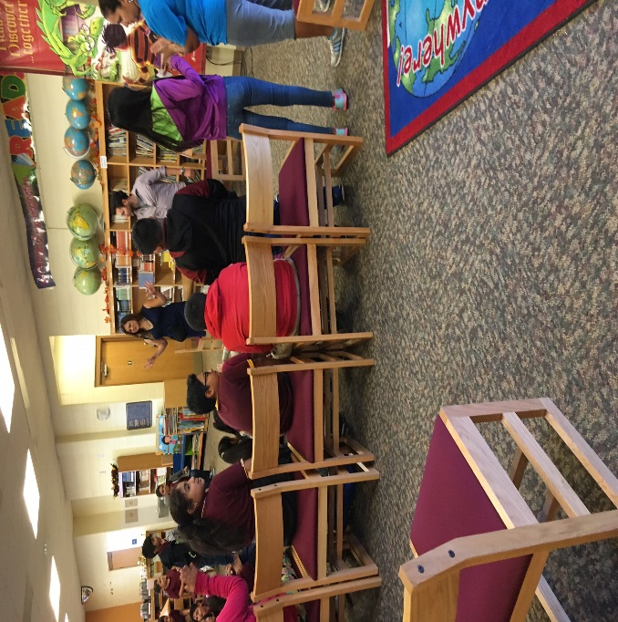
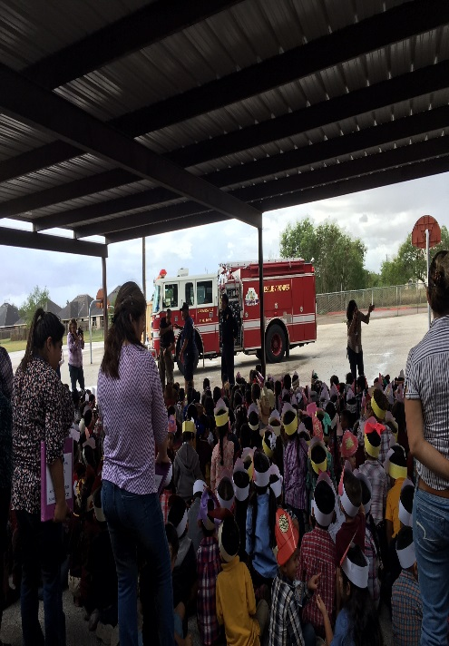
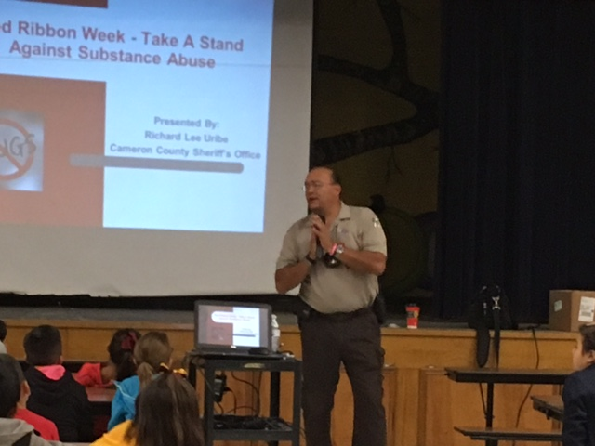
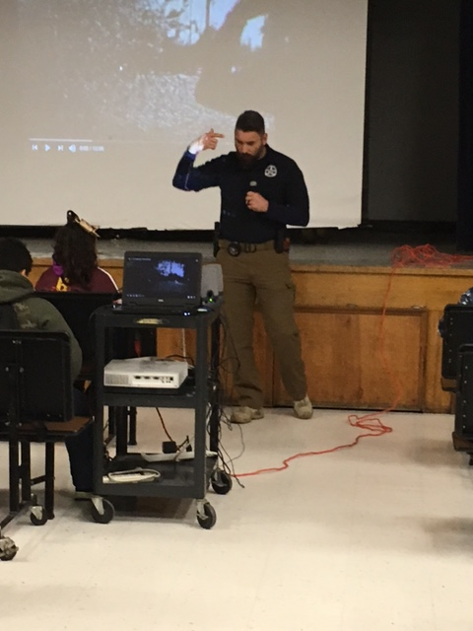
21st Century Workforce Development rated Recognized
During the 2016-2017 school year our students were visited by our Career Day guest speakers, as well as many other guests including Author Ricky Pitman, , The Tooth Place, Firefighter Department, Cameron County Clerks, Channel 5 News Anchor Daisy Martinez, BPD Criminal Investigators, Dr. Marguerite DeWitt from UTRGV, and US Marshals Deputy Oscar Silva to name a few. Our teachers have supported College Awareness by displaying their Education background outside their classrooms and our Campus has participated in several College Awareness Days.

Slide 6
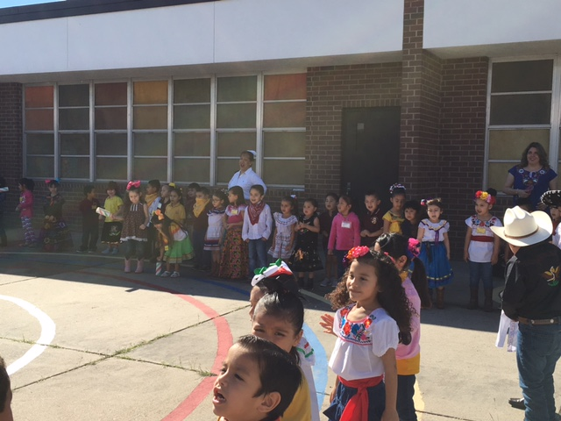
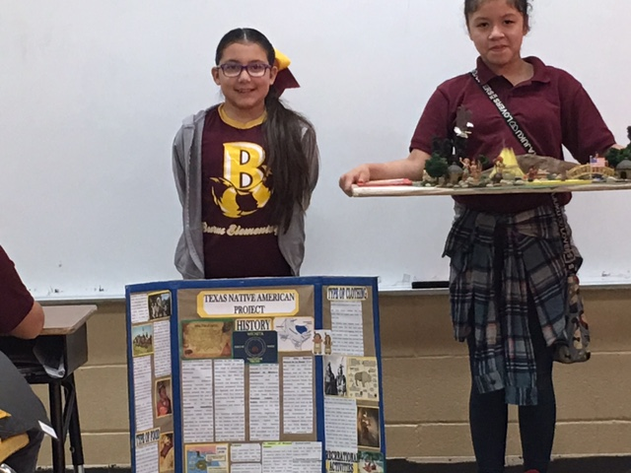
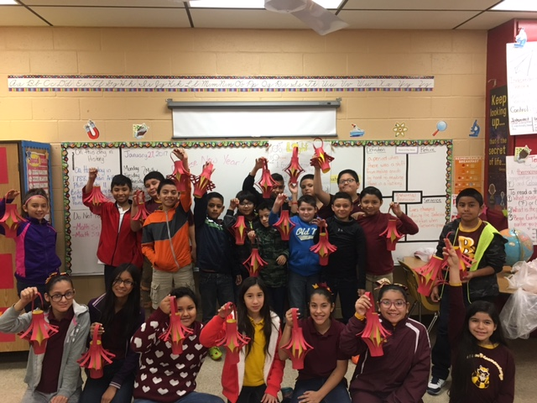
Second Language Acquisition rated Recognized
Burns Elementary participated in Parade of Characters, Day of the Dead, Dia de los Reyes, Dia de el Nino, Christmas Program, 16 de septiembre, Black Heritage Month, Chinese New Year, Native American Heritage Month, Constitution Day, Kids Voting, and Just Say No Activities. The students, parents, teachers, and staff had the opportunity to participate in these exciting cultural activities.

Slide 7
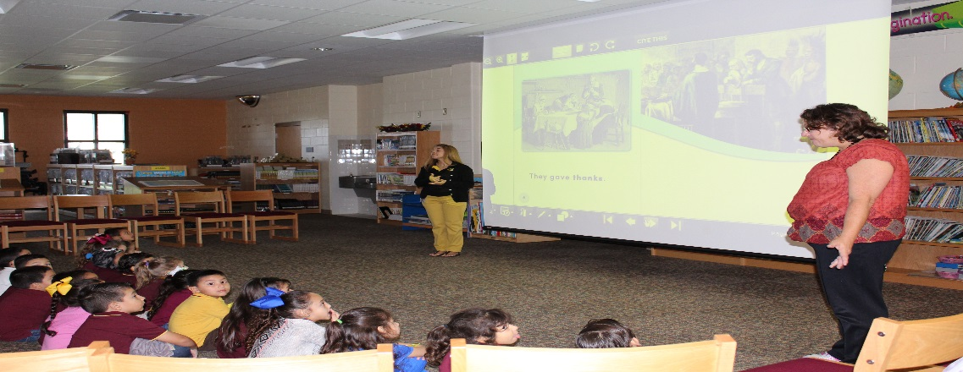
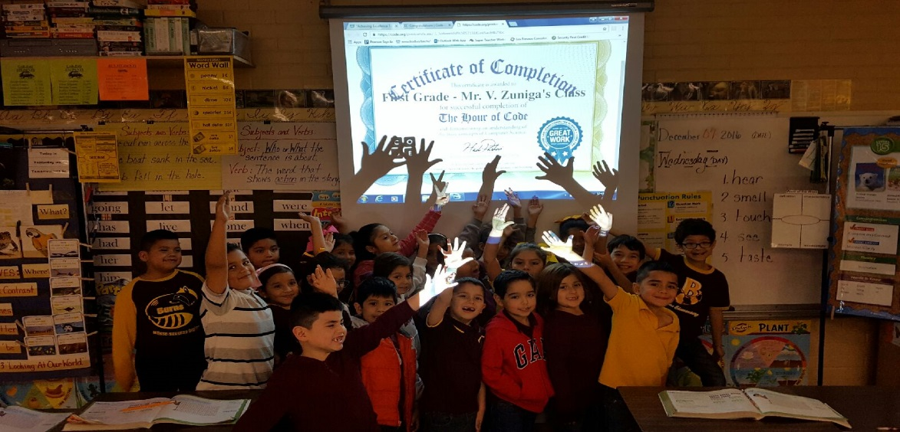
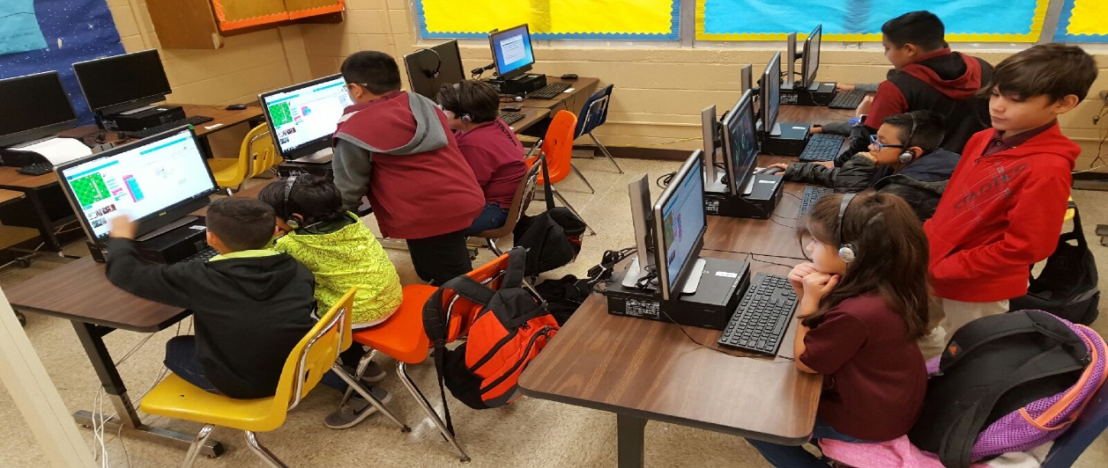
Digital Learning Environment rated Recognized
At Burns Elementary education is aimed at supporting technology integration into the campus. Our fourth and fifth grade students had the opportunity to join our Coding Club and take on different challenges. The lower grades have had the opportunity to use Ipads with educational games and experience reading on Beehive. The upper grades implement Istation and Think Through Math at our Computer Labs or district provided laptops (COWS). Teachers have also begun using digital forms of communication between students, parents, and school.

Slide 8
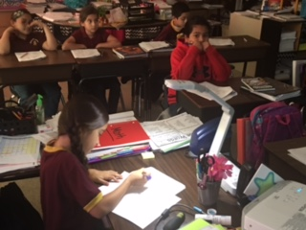
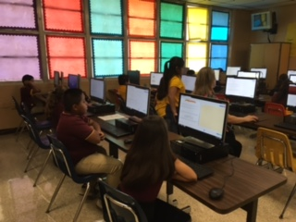
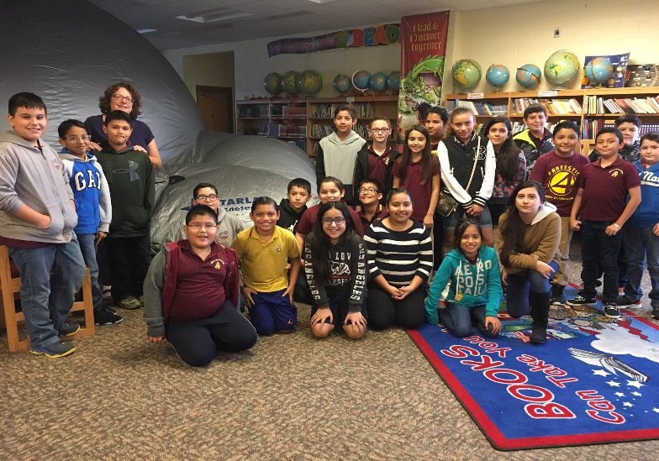
Dropout Preventions Strategies rated Recognized
The attendance rate of the At-Risk population was more than 95% based on PEIMS attendance report for the 2016-2017 school year. This population participated in accelerated instruction before and after school as well as Saturday tutorial program to help in their academic development. They also had the opportunity to participate in the Extended Day Enrichment Program.

Slide 9
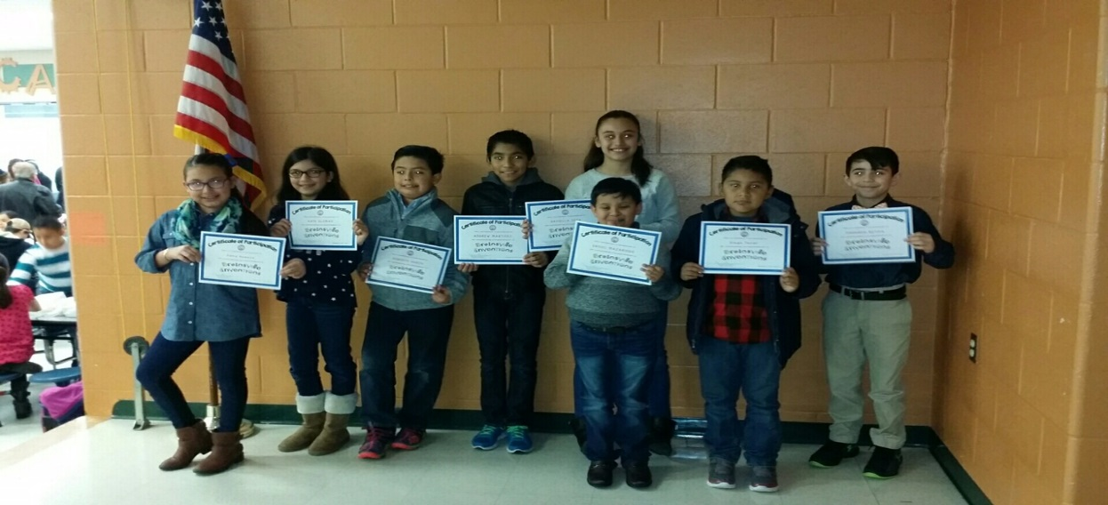
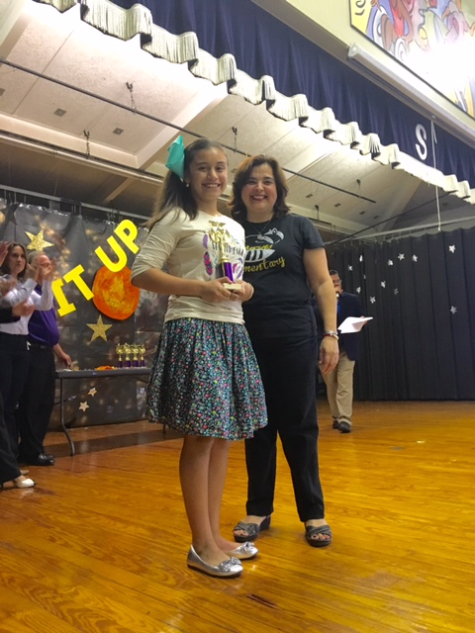
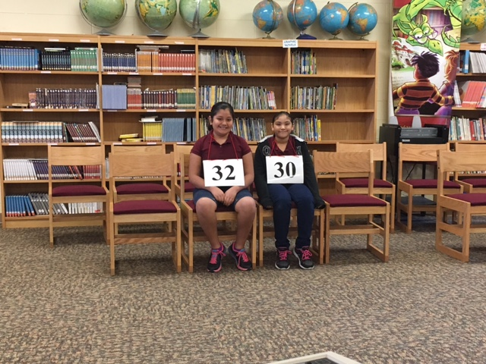
Educational Programs for G/T rated Recognized
Our Gifted and Talented student population at Burns Elementary is given the opportunity to showcase their talents in such events as Chess, Science Fair, Spelling Bee, and UIL academic competitions. This year was the second year in a row that Burns Elementary competed in Brainsville Competition and brought home some trophies!

